Slide 1

Vehicle Collision Prediction Using FastAPI & ML
K. Akarsh Chowdary
K. Amit
B . V. Suneel Kumar

Slide 2
Problem Statement
Existing vehicle safety systems rely mainly on fixed rule-based thresholds to detect potential collisions. These systems lack the ability to intelligently analyze driving parameters in real time and accurately classify different levels of collision risk. Additionally, many existing solutions do not provide persistent data storage, which limits capabilities for continuous monitoring, auditing, and performance analysis.

Slide 3
Objectives
Create Dataset
Generate a synthetic vehicle sensor dataset using Python's random module with noise simulation (1000 samples) covering safe, risk, and high-risk scenarios.
Train an ML Model
Build a classifier with Random Forest Algorithm and hyperparameter tuning and cross-validation to accurately predict vehicle safety status.
Deploy a REST API
Use FastAPI to expose the ML model as a real-time endpoint that accepts sensor JSON data and returns predictions.
Integrate a Database
Store all prediction records (inputs + outputs) in a relational database for audit trails and future analytics.
Enable Real-Time Monitoring
Achieve end-to-end pipeline: sensor data → prediction → storage → JSON response in milliseconds.

Slide 4
Technology's Used
Language: Python 3.x
Data Processing: Pandas & NumPy
ML Library: Scikit-learn
Frontend UI: React
Web Framework: Fast API
Database: SQLite

Slide 5
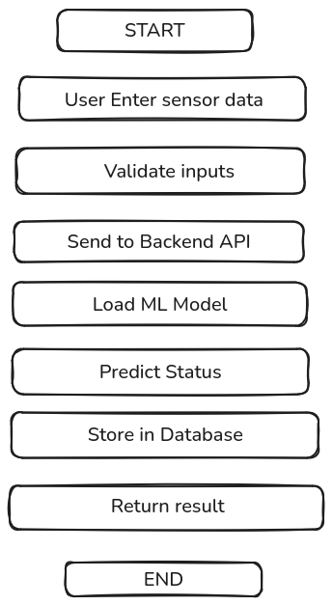
Work Flow

Slide 6
Dataset Generation for Collision Risk Detection
The objective of this dataset generation process is to create a dataset that simulates different vehicle driving scenarios for training a machine learning model to predict collision risk levels.
Dataset Features:
The generated dataset includes the following parameters that represent vehicle dynamics and environmental conditions:
Distance – Distance between the vehicle and the object ahead
Time-To-Collision (TTC) – Estimated time before a collision occurs if current speed is maintained
Axis – Lateral position of the detected object relative to the vehicle lane
Speed – Speed of the vehicle
Steering Angle – Current steering angle of the vehicle
Relative Velocity – Speed difference between the ego vehicle and the object ahead
Status – Collision risk category (High Risk, Risk, Safe)
The dataset is stored in a CSV file and used for training machine learning models.

Slide 7
Data Generation Process
The dataset is generated using Python's random and csv libraries to simulate realistic vehicle driving conditions.
Process
Define realistic ranges for vehicle parameters.
Generate random values within these ranges.
Apply rule-based logic to determine the collision risk level.
Parameter Ranges Used
Distance: 3– 150 meters
TTC: 0.3 – 13 seconds
Axis Offset: -1.5 – 1.5 meters
Vehicle Speed: 40– 140 km/h
Steering Angle: -15° – 15°
Relative Velocity: 05– 25 m/s

Slide 8
Collision Risk Classification
A rule-based labeling function is used to classify each generated scenario into a collision risk category.
High Risk
A scenario is labeled as High Risk when:
Time-To-Collision (TTC) ≤ 1.5 seconds OR
Distance < 8 meters and relative velocity > 6 (meter/sec)
This indicates an imminent collision situation requiring immediate action.
Risk
A scenario is labeled as Risk when:
1.5 < TTC ≤ 4 seconds.
This indicates a moderate collision risk where caution is required.
Safe
A scenario is labeled as Safe when:
TTC > 4 seconds.
This indicates safe driving conditions with low collision probability.

Slide 9
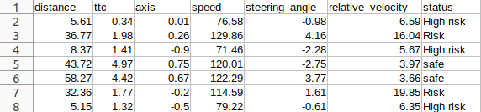
Data Set

Slide 10
Machine Learning Pipeline Overview
The objective of this stage is to train a machine learning model that can classify vehicle driving scenarios into different collision risk levels.
The workflow includes the following steps:
1) Loading the dataset
2) Adding realistic sensor noise
3) Creating class overlap to simulate uncertainty
4) Preparing features and labels
5) Training the machine learning model
6) Performing cross-validation
7) Evaluating the model performance
8) Saving the trained model for deployment
The model used in this project is the Random Forest Classifier, an ensemble learning method that combines multiple decision trees to improve prediction accuracy and robustness.

Slide 11
Data Preprocessing and Noise Simulation
After loading the dataset, preprocessing steps are applied to simulate real-world sensor behavior.
Sensor Noise Injection
Real vehicle sensors such as radar, LiDAR, and cameras are subject to measurement errors. To simulate this behavior, Gaussian noise is added to key parameters:
Time-To-Collision (TTC)
Distance
Relative Velocity
Example noise parameters:
TTC noise: mean = 0, standard deviation = 0.2
Distance noise: standard deviation = 0.6
Relative velocity noise: standard deviation = 0.3
Adding noise ensures that the dataset more closely represents real-world driving conditions.

Slide 12
Class Overlap and Data Preparation
To make the dataset more realistic, label uncertainty is introduced.
Class Overlap Creation
Approximately 8% of the labels are randomly modified.
This prevents the model from learning perfectly separable rules.
It simulates real-world uncertainty in sensor-based collision detection.
Feature and Target Separation
The dataset is divided into:
Features (Input Variables):
Distance, Time-To-Collision (TTC), Axis, Speed, Steering Angle, Relative Velocity
Target Variable:
Status (High Risk, Risk, Safe)
Categorical labels are converted into numeric values using one-hot encoding to make them compatible with machine learning algorithms.

Slide 13
Model Training and Cross Validation
The dataset is divided into training and testing sets:
Training Set: 80% of the data
Testing Set: 20% of the data
The model used is the Random Forest Classifier, which builds multiple decision trees and combines their outputs to improve prediction accuracy.
Model Hyperparameters
Number of Trees: 200
Maximum Depth: 7
Minimum Samples Split: 6
Minimum Samples per Leaf: 3
Cross Validation
To ensure the model generalizes well, 10-fold cross-validation is applied.
The final performance is calculated as the average accuracy across all folds, providing a more reliable evaluation.

Slide 14
Model Evaluation and Deployment
Evaluation Metrics
Accuracy Score – Overall prediction correctness
Confusion Matrix – Shows correct and incorrect predictions for each class
Classification Report – Includes Precision, Recall, and F1-score
Feature Importance
Random Forest provides feature importance values, indicating which parameters most influence collision risk prediction.
Typically, important features include:
Time-To-Collision (TTC)
Distance
Relative Velocity
Model Deployment
The trained model is saved as a Pickle (.pkl) file:

Slide 15
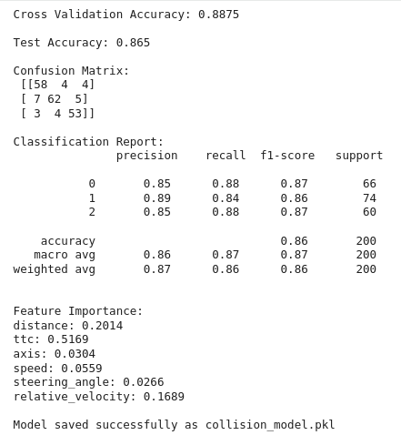
Output Image

Slide 16
Web Development Overview
Frontend (React): Builds the user interface where users input sensor data and view predictions.
Backend (FastAPI): Handles the prediction logic, stores data, and serves the frontend with results.
Database (SQLite): Stores historical prediction data for later retrieval.
Communication(CORS): RESTful APIs for interaction between the frontend and backend.

Slide 17
Frontend: React Application
Main Functionality:
Collects sensor input from the user.
Displays prediction results (SAFE, RISK, HIGH RISK).
Fetches and displays prediction history.
Key Components:
App.js: Main UI component that handles form submission, communicates with the backend, and displays prediction and history.
History Table: Shows a list of past predictions including sensor values and the resulting safety status.
Status Visualization: Visual elements like color coding for safety levels (e.g., green for SAFE, orange for RISK, red for HIGH RISK).

Slide 18
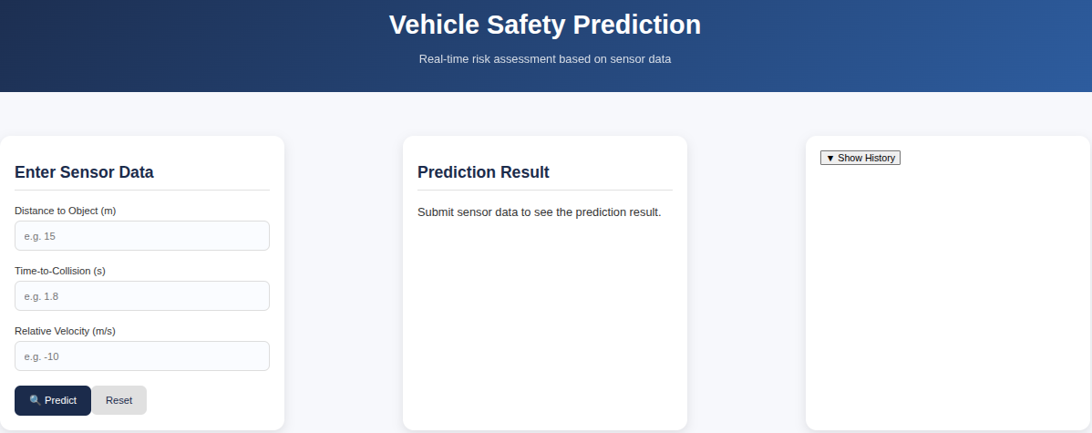
FrontEnd UI

Slide 19
Backend: FastAPI
Main Role: Handles API requests (e.g., /predict, /history), runs the safety prediction model, and saves predictions in the database.
Key Features:
POST /predict: Accepts sensor data, processes the prediction, and returns the safety status.
GET /history: Fetches the prediction history (with a limit parameter for pagination).
Model Inference: Loads the trained Random Forest model and makes real-time predictions based on incoming data.

Slide 20
Database: SQLite
Purpose: Stores prediction history for future reference and auditing.
Key Fields in Database:
Sensor Inputs: Distance, TTC, Axis, Speed, Steering Angle, Relative Velocity.
Predicted Status: The safety level determined by the model (SAFE, RISK, HIGH RISK).
Timestamp: The time of the prediction.
Backend Interaction:
Predictions are stored after each request (POST /predict).
History can be retrieved by frontend (GET /history).

Slide 21
Frontend and Backend Communication
Frontend (React) sends sensor data to the FastAPI backend using an HTTP POST request.
Endpoint: /predict
Request Body: Sensor data (e.g., distance, speed, steering_angle)
FastAPI Backend:
Receives and validates the incoming sensor data.
Runs ML model inference to predict safety status.
Stores input and prediction records in SQLite.
Returns the prediction response to the frontend.
Frontend Response Handling
Displays the predicted safety result to the user.
Updates the prediction history table in the UI.

Slide 22
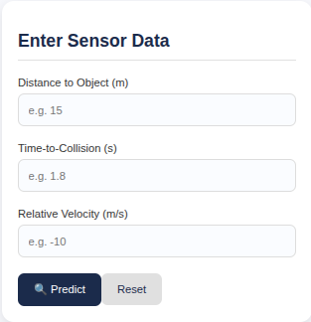
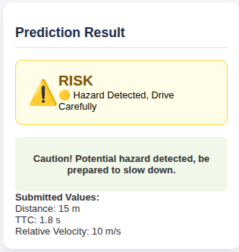
Output
Input:
Output:

Slide 23
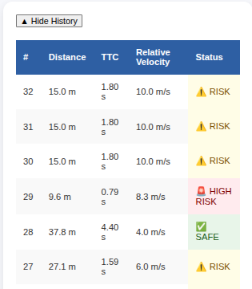
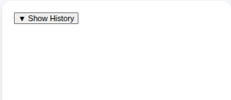
Predicted History

Slide 24
Advantages and Limitations
Pros:
Instant Safety Alerts
Provides immediate safety predictions based on real-time sensor data, helping prevent accidents.
Accurate, Data-Driven Decisions
Uses sensor data to make reliable predictions, eliminating guesswork and human error.
History Tracking for Improvement
Keeps a record of all predictions, enabling data analysis to improve safety over time.
Cons:
Relies on Sensor Accuracy
Inaccurate or faulty sensors can lead to wrong safety predictions.
No Real-Time Model Updates
The system uses a fixed model, so it can't adapt to new data without manual updates.
Not Ideal for Large-Scale Use
SQLite may struggle with performance as the amount of data grows.

Slide 25
Future Scope
Model Retraining:
Enable regular updates and retraining of the model based on new sensor data to improve predictions over time.
Advanced Error Handling:
Implement more robust validation and error handling for the API and sensor data input.
Cloud Deployment:
Deploy the system on cloud platforms (AWS, Azure, etc.) for greater scalability and public access.
Integration with Vehicle Systems:
Integrate the system directly with onboard vehicle sensors for real-time safety alerts during driving.
Automated Testing:
Implement unit and integration tests to improve the stability of the application.

Slide 26
Conclusion
The Vehicle Safety Prediction System helps improve vehicle safety by providing real-time, data-driven predictions based on sensor data. It tracks prediction history, allowing for better decision-making over time. Although there are some limitations, like reliance on accurate sensors and scalability issues with SQLite, the system is a solid step toward safer driving. Future improvements, such as cloud deployment and real-time model updates, will make the system even more reliable and scalable.

Slide 27
Thank You

